Slide 1
Chapter 1 Objectives
The CCNA Topics Covered in this chapter include:
  Routing Basics
  Function of Router
  Different classification of routing protocols
  IGP and EGP
  Classful Routing Protocols
  Classless Routing Protocols

Slide 2
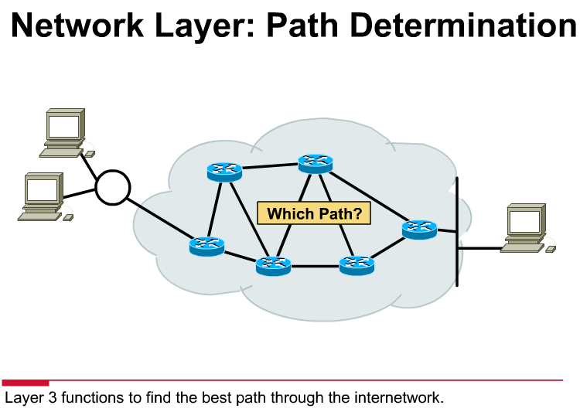

Slide 3
Path determination, for traffic going through a network cloud, occurs at the network layer (Layer 3).
The path determination function enables a router to evaluate the available paths to a destination and to establish the preferred handling of a packet.
The network layer provides best-effort end-to-end packet delivery across interconnected networks.
The network layer uses the IP routing table to send packets from the source network to the destination network.
After the router determines which path to use, it proceeds with forwarding the packet.
It takes the packet that it accepted on one interface and forwards it to another interface or port that reflects the best path to the packet's destination.

Slide 4
A router generally relays a packet from one data link to another, using two basic functions:
1. a path determination function - Routing
2. a switching function – Packet Forwarding
The path determination function enables the router to select the most appropriate interface for forwarding a packet.
The switching function allows a router to accept a packet on one interface and forward it through a second interface.

Slide 5



What is Routing?
10.120.2.0
172.16.1.0
To route, a router needs to know:
  Destination addresses
  Sources it can learn from
  Possible routes
  Best route
  Routers must learn destinations that are not directly connected

Slide 6
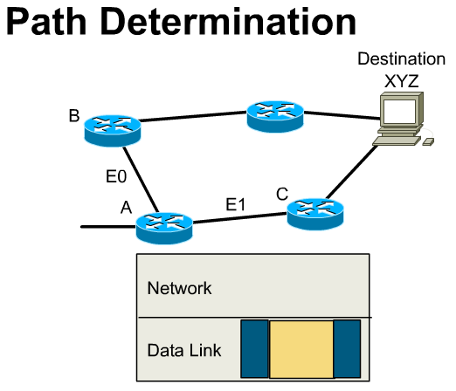
Very important points:
Packet: IP Source and IP Destination (Network Layer) addresses do not change.
Data Link Source and Data Link Destination addresses do change to reflect the current and next hop routers.
The routing table (coming) contains the IP address of the next-hop router – This address is used to find the Data Link Destination address which is used to encapsulate the original IP packet.
The router’s path determination function looks up the network address in the routing table and determines which interface it should exit.
The router’s switching function encapsulates it in the proper data link frame with the proper data link destination address.

Slide 7
Routing vs. Routed
Routing protocols are used between routers to:
  Determine the path of a packet through a network
  Maintain routing tables
  Examples : IGP and EGP
Routed protocols are:
  Assigned to an interface
  Once the path is determined by the Routing protocol, determines method of delivery
  Examples : IP, IPX

Slide 8
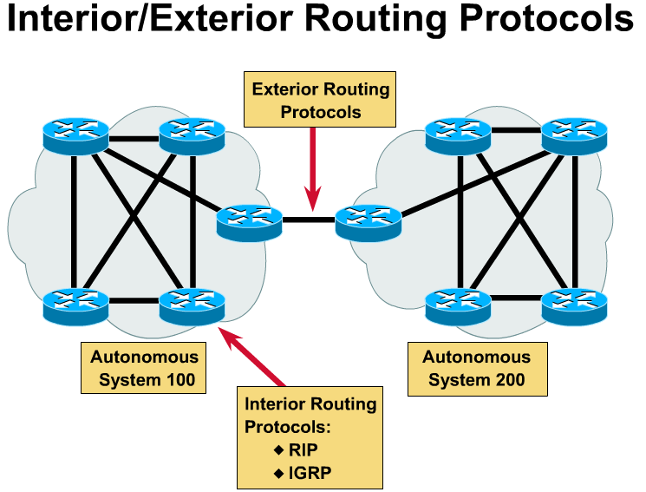
Autonomous System (AS) – Networks under the control of a single organization (within a single company).
IGP – Routing protocols used within an AS.
EGP – Routing protocols used between AS’s

Slide 9
Classful Routing Overview
  Classful routing protocols do not include the subnet mask with the route advertisement.
  Within the same network, consistency of the subnet masks is assumed.
  Summary routes are exchanged between foreign networks.
  Examples of classful routing protocols:
    RIP Version 1 (RIPv1)
    IGRP

Slide 10
Classless Routing Overview
  Classless routing protocols include the subnet mask with the route advertisement.
  Classless routing protocols support variable-length subnet masking (VLSM).
  Summary routes can be manually controlled within the network.
  Examples of classless routing protocols:
    RIP Version 2 (RIPv2)
    EIGRP
    OSPF
    IS-IS

Slide 11

Administrative Distance
Router A
Router B
IGRP
Administrative
Distance=100
RIP
Administrative
Distance=120
Router C
Router D
Default Administrative Distance
Directly Connected: 0
Static Route: 1
RIP: 120
IGRP: 100
EIGRP: 90
OSPF: 110

